Slide 1
Introduction to Climate Change
Key Stage 3

Slide 2
Climate and Earth Systems
Lesson 1

Slide 3
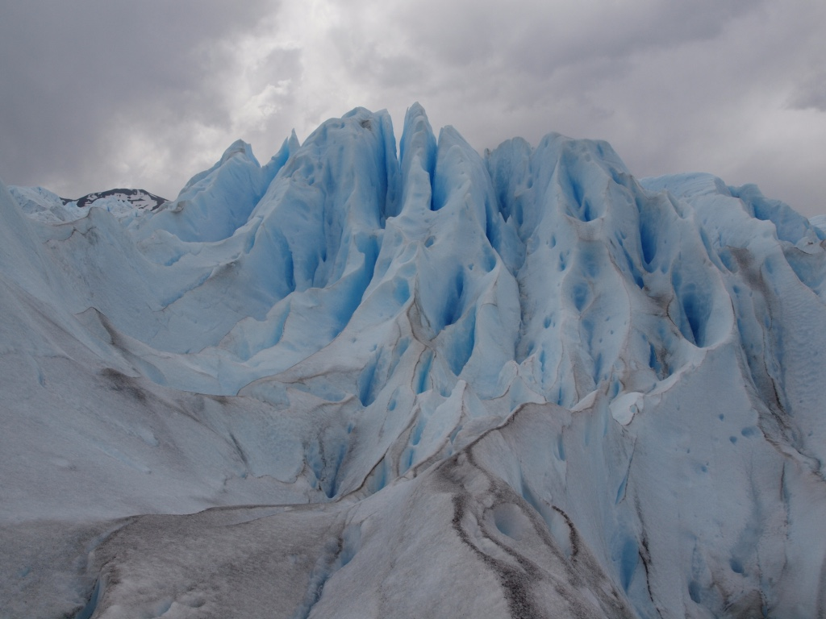
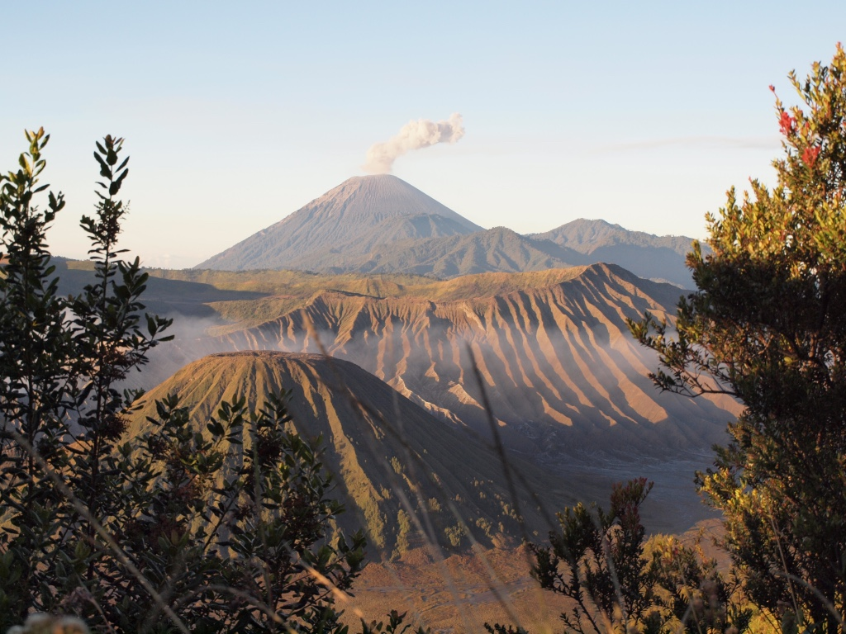
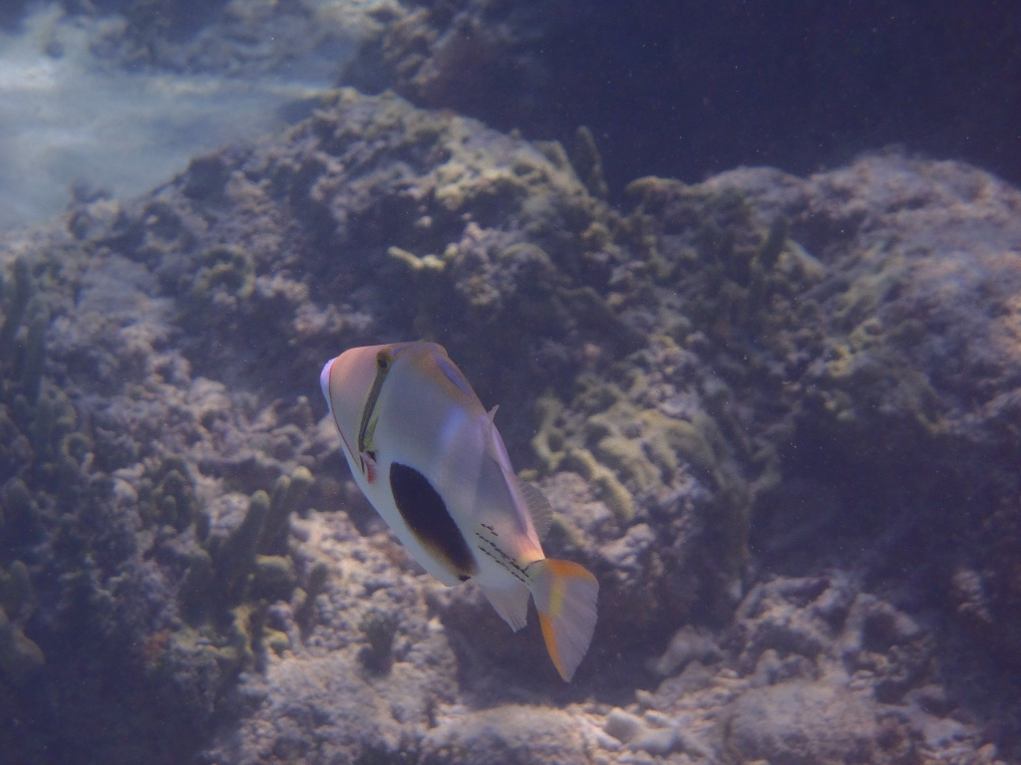

What is Climate?
Time
Tens of thousands of years
Decades
Every few years
Months
Days and weeks
Ice advances and retreats as global temperatures fluctuate due to small changes in the amount of solar energy received by earth
Volcanic eruptions release particles into the air, reflecting energy from the sun before it reaches earth
Changes in ocean currents cause normal weather patterns to shift to a different state – El Nino
Seasons result from the earth’s rotation around a tilted axis
Weather is the result of short term interactions between earth systems
Climate = average weather over long periods
What has the weather been like today? How is this different to climate?

Slide 4
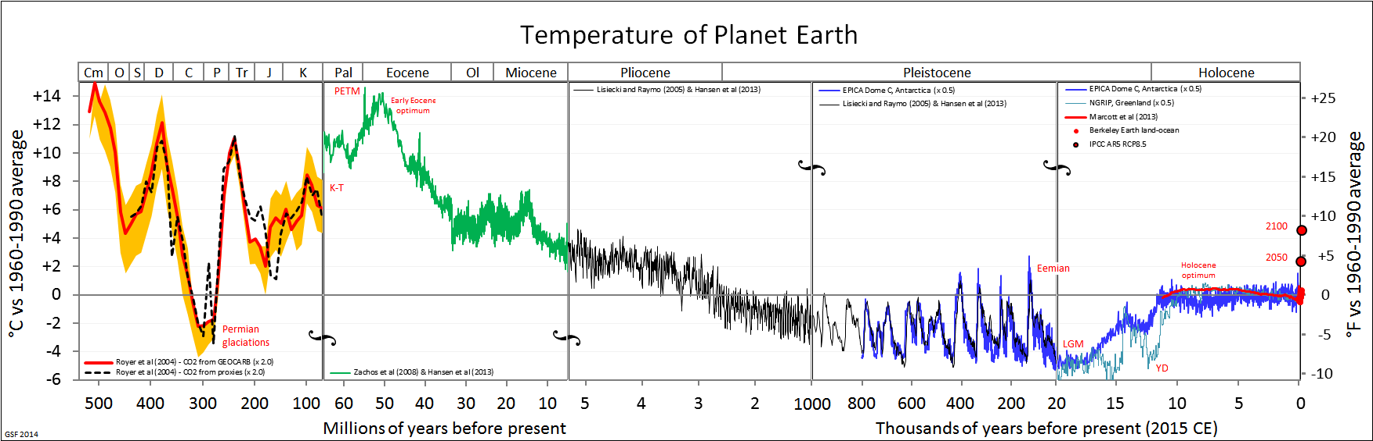
The Earth’s climate has changed significantly over Earth’s history

Slide 5

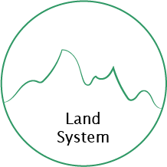
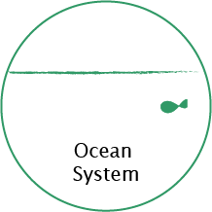
Earth systems
Earth Energy Systems
Earth is a dynamic system in which the atmosphere, land and oceans interact with each other.
Changes in one of these systems impacts on the other systems.
What are the main features of each system?

Slide 6
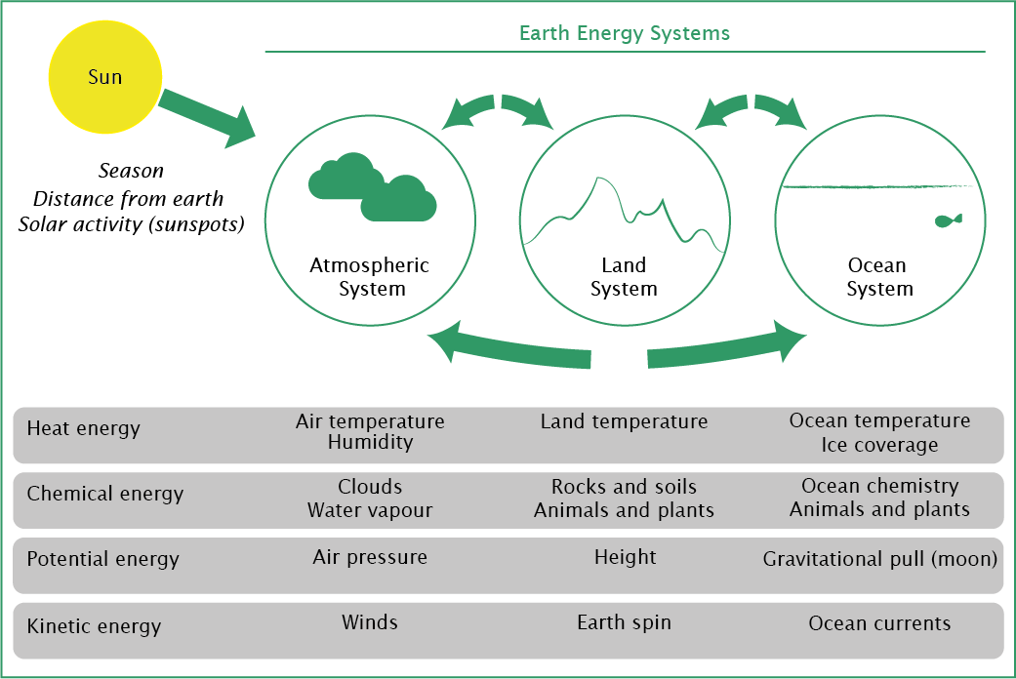
Energy flows between the earth systems drives climate

Slide 7
Earth system energy flows – fill the gaps
Match the processes with the applicable inputs / outputs and provide a justification for your answer
Input System Energy Store - Type | Process | Output System Energy Store – Type
Atmosphere – temperature / pressure |  | Atmosphere – temperature / pressure
Atmosphere - light |  | Land - chemical
Land / Oceans - heat |  | Atmosphere - heat
Oceans – temperature / chemical |  | Oceans – temperature / chemical
Atmosphere - heat |  | Land / Oceans - heat
Land - chemical |  | Oceans / Atmosphere - chemical
Ocean Currents
Evaporation
Winds
Radiation
Photosynthesis
Erosion

Slide 8
Earth’s energy flows – fill the gaps
Match the processes with the applicable inputs / outputs and provide a justification for your answer
Input System Energy Store - Type | Process | Output System Energy Store – Type
Atmosphere – temperature / pressure | Winds Differences in air temperature cause pressure differentials driving wind | Atmosphere – temperature / pressure
Atmosphere - light | Photosynthesis Plants capture light energy and convert to chemical energy | Land - chemical
Land / Oceans - heat | Radiation The land and oceans radiate heat into the atmosphere | Atmosphere - heat
Oceans – temperature / chemical | Ocean Currents Differences in water temperature and salinity drive ocean currents | Oceans – temperature / chemical
Atmosphere - heat | Evaporation Evaporation requires the transfer of heat from the atmosphere to the water being evaporated | Land / Oceans - heat
Land - chemical | Erosion The erosion of land transfers the chemical energy stored in rocks or soils to the atmosphere or oceans | Oceans / Atmosphere - chemical

Slide 9
The Carbon Cycle
Lesson 2

Slide 10
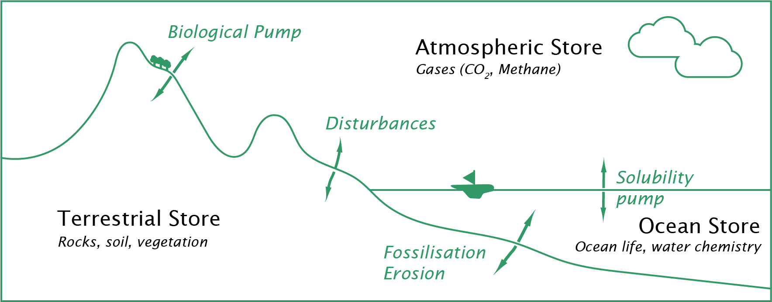
The Carbon Cycle
Biological pump – the absorption of carbon by organic matter through photosynthesis
Solubility pump – carbon dioxide is a soluble gas and is dissolved in the sea and rivers
Fossilisation and erosion – carbon in dead organic matter is fossilised through heat and pressure to form rocks, whilst rocks are at the same time being eroded by rivers and the oceans
Disturbances such as forest fires, volcanic eruptions and burning fossil fuels release carbon from one store to another.

Slide 11
The carbon cycle is driven by natural and man-made processes
Natural processes
Man-made processes
Biological pump
Rainforests absorb CO2 through the operation of photosynthesis.
The removal of forest areas to meet demands for wood as a fuel or product (e.g. furniture, building materials) reduces the amount of CO2 being absorbed.
Disturbances
Volcanic eruptions release greenhouse gases into the atmosphere.
The extraction of fossil fuels (such as coal) and burning such fuels to generate electricity releases carbon stored in these rocks to the atmosphere.
Fossilisation / erosion
The natural erosion of limestone by naturally acidic rainwater and seawater releases carbon dioxide back to the atmosphere.
The release of CO2 and SO2 into the atmosphere as a result of human activities, such as burning coal, c
Solubility pump
Natural processes
Man-made processes

Slide 12
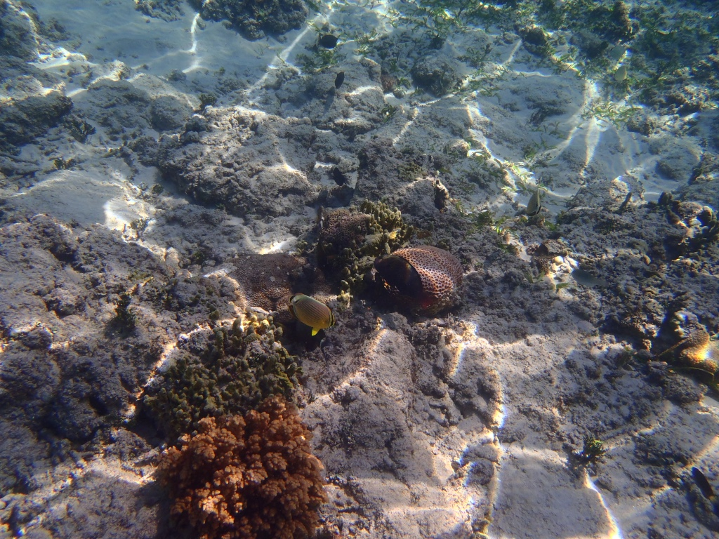
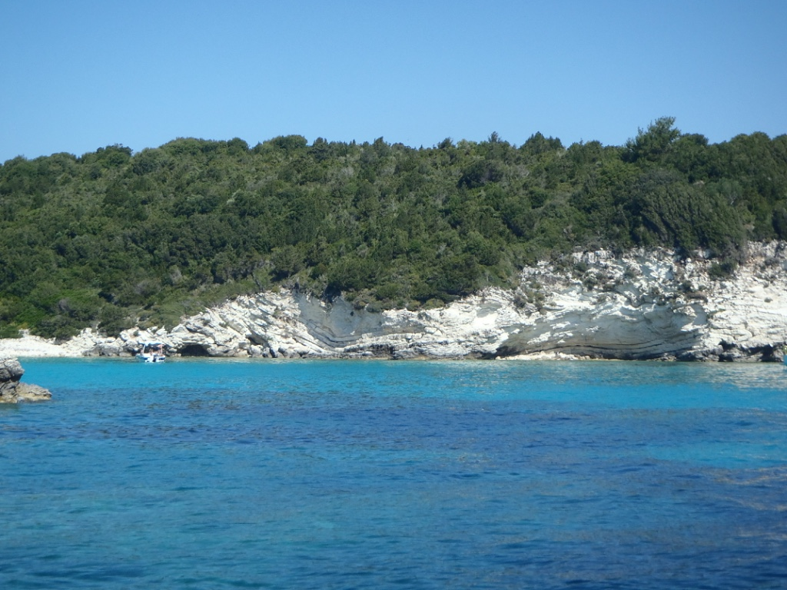
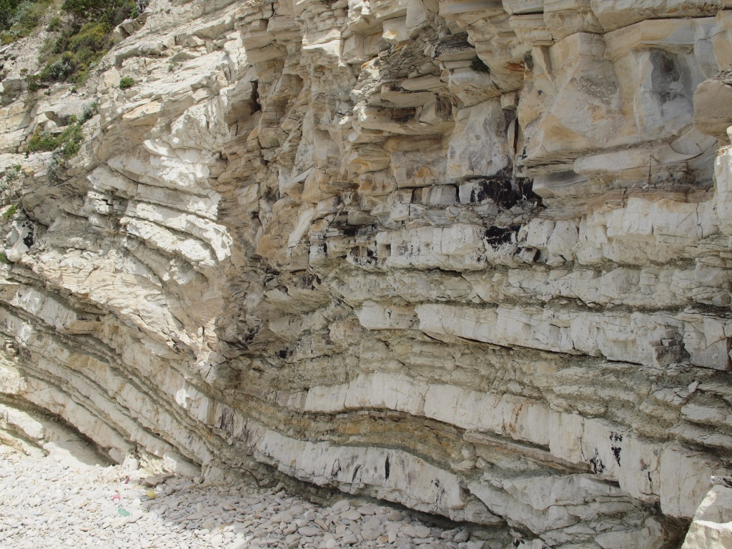
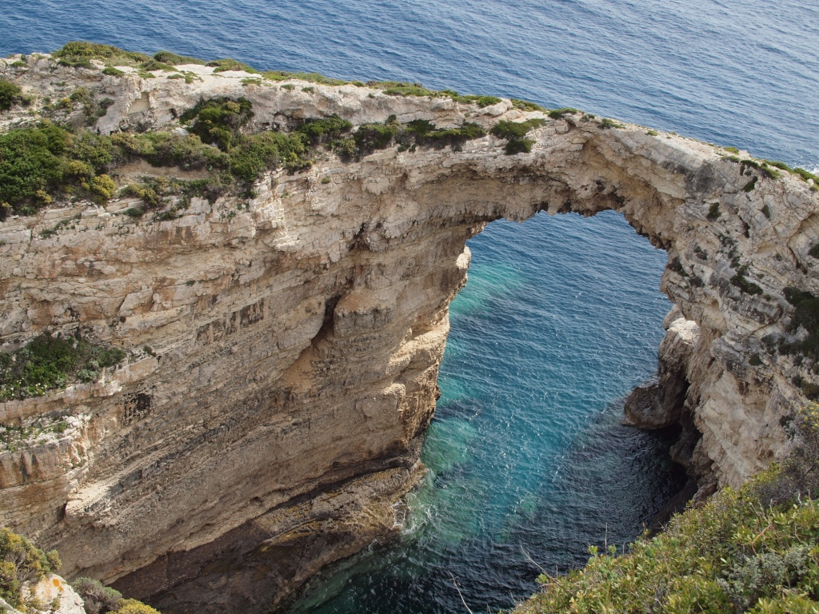
Carbon cycle example: Limestone (CaCO3)
Biological Pump
Fossilisation
Erosion
Plants such as coral and algae absorb carbon from the atmosphere through photosynthesis. Marine life (e.g. fish) eat these plants, incorporating this carbon in their bodies in energy stores such as carbohydrates.
In shallow tropical seas, as plants and animals die the remains (e.g. skeleton) falls to the sea bed, where it accumulates over time.
Over time, heat and pressure is applied to this material to form sedimentary rocks
This rock becomes exposed and is eroded (through dissolution) by rivers and the oceans, releasing carbon back into the atmosphere.
This occurs as an ongoing natural process with the absorption and production of carbon occurring over similar timeframes = no net flows of carbon to or from any store

Slide 13

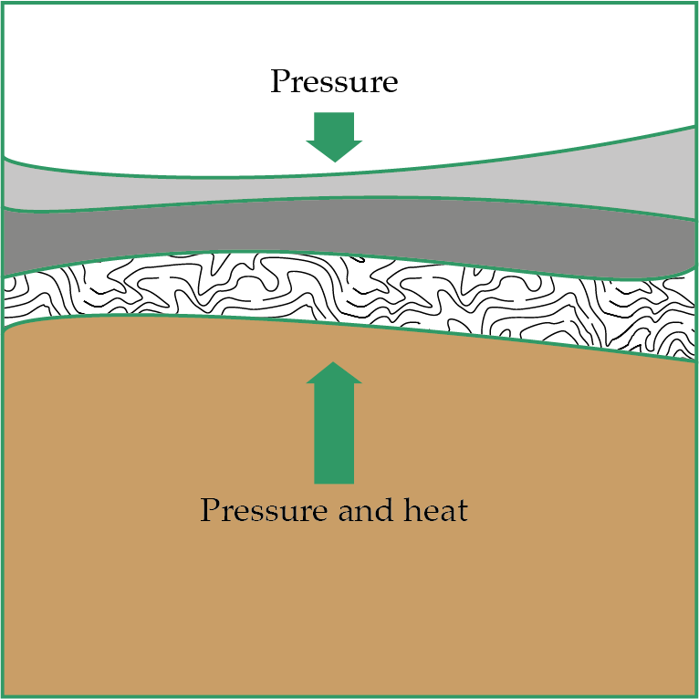
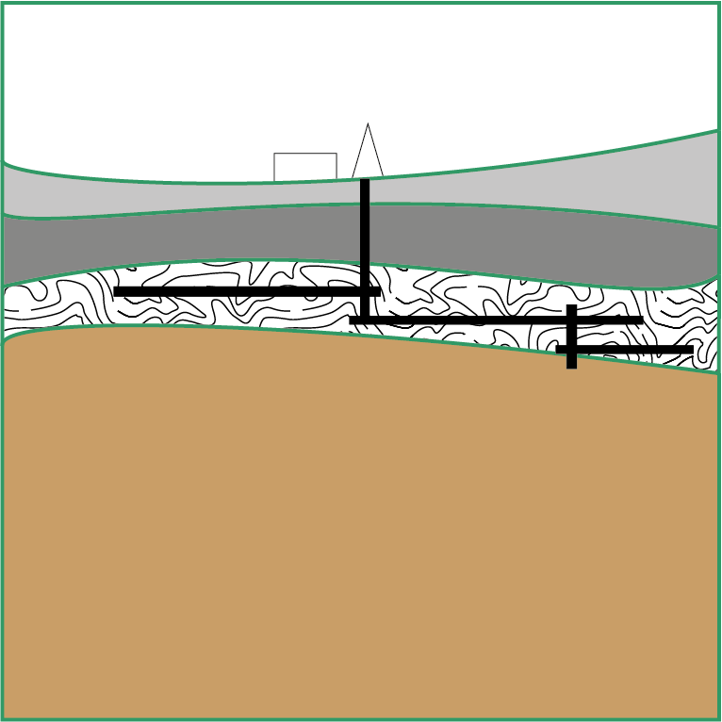
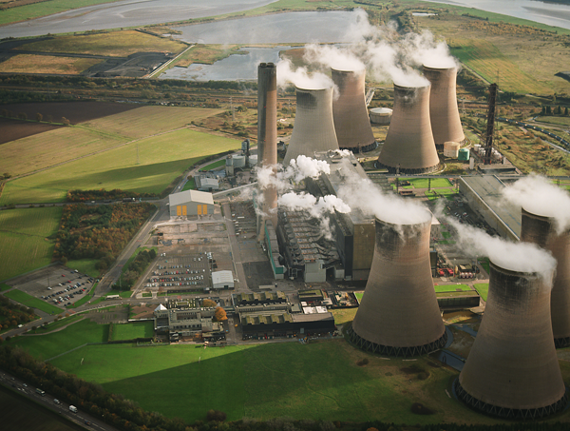
Carbon cycle example: Coal
Biological Pump
Fossilisation
Disturbance
Ferns, trees and other organic material absorb CO2 from the atmosphere through photosynthesis. This material dies and is incorporated into the earth’s surface.
Heat and pressure is applied to the layers in the earth’s surface over millions of years, transforming the deposits into a metamorphic rock type. Coal is an example of a metamorphic rock.
Coal seems are extracted through coal mining, involving deep or open cast mining.
Coal is burned in coal power stations to produce electricity. Through the combustion of coal, the CO2 that was trapped as part of the photosynthesis process is released back to the atmosphere.
The extraction and use occurs faster than the production = net carbon flow to atmosphere

Slide 14
Carbon Budget exercise
Complete the gaps with the carbon flows that have occurred for each activity. Add up the flows to identify how the carbon stores have changed.
 | Carbon Flow Type | Cause (Natural / Man made) | Carbon Flows (tonnes)
 |  |  | Terrestrial store | Ocean Store | Atmospheric Store
Opening balance (tonnes) | n/a | n/a | 150,000,000 | 400,000,000 | 250,000,000
Volcanic eruption in Indonesia | Disturbance | Natural | (200,000) | 0 | 200,000
Combustion of gas for energy in a power station over a year | Disturbance |  |  |  | 20,000
River erodes a cave system in limestone rock in a year |  | Natural |  | 40,000
Photosynthesis occurs in a rainforest over a year | Biological pump |  | 35,000
A forest containing 10,000 tonnes of carbon is cut down and used for firewood. |  | Man-made
Oceans absorb carbon dioxide over a year |  |  |  |  | (500,000)
Closing balance (tonnes) | n/a | n/a

Slide 15
Human Production of Greenhouse Gases
Lesson 3

Slide 16
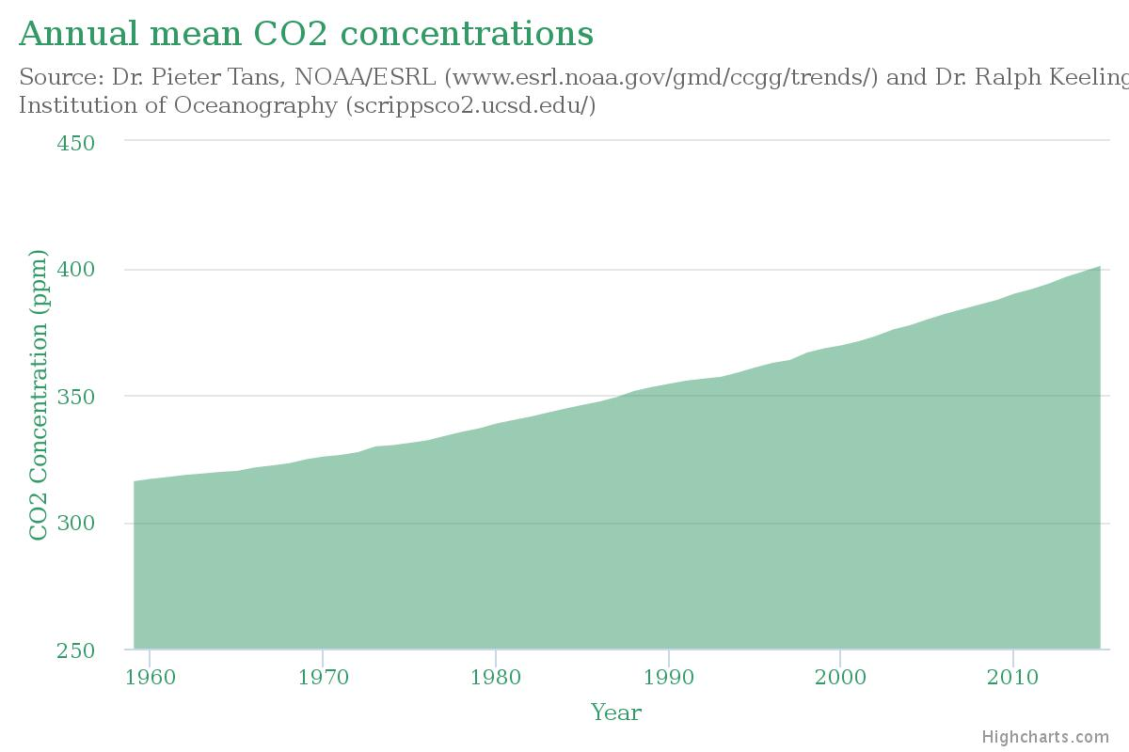
Atmospheric CO2 concentrations
Global CO2 concentrations are measured at an observatory at Mount Loa, Hawaii

Slide 17
How do humans produce greenhouse gases?
Energy production
Electricity Generation
Heat Generation
Transport
Land use change
Waste Management

Slide 18
How do humans produce greenhouse gases?
Energy production
Electricity Generation
Fossil fuels, including CO2, are released when fossil fuels, such as coal, oil and gas, are burnt to generate electricity.
Power stations use the heat generated from the combustion of fossil fuels to produce steam at high temperature and pressure, which is converted to electrical energy by a steam turbine and generator.
Heat Generation
Transport
Land use change
Waste Management

Slide 19

How do humans produce greenhouse gases?
Energy production
Electricity Generation
Heat is required:
in buildings to raise the temperature;
in industrial applications (e.g. cement production, paper production) to assist with the processes used to manufacture certain products.
In each case, fossil fuels are used, which released CO2 into the atmosphere:
Gas or oil boilers in homes and buildings;
Coal (for example in cement production)
Heat Generation
Transport
Land use change
Waste Management

Slide 20
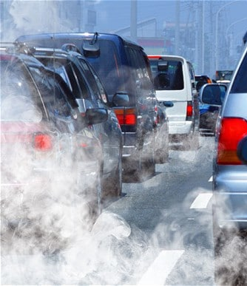
How do humans produce greenhouse gases?
Energy production
Electricity Generation
Cars and other vehicles that are powered by the internal combustion engine produce kinetic energy through the combustion of petrol or diesel, each a fossil fuel. CO2 is released as a result.
Aircraft also burn a form of oil to power their engines. This releases CO2 and other greenhouse gases high in the atmosphere. Releasing greenhouse gases at high altitudes is more damaging as the effects on the climate are more significant.
Ships also use a form of oil in their large engines and contribute CO2 to the atmosphere.
Heat Generation
Transport
Land use change
Waste Management

Slide 21
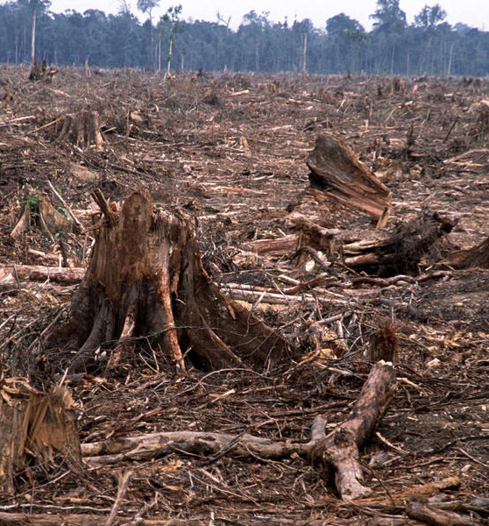
How do humans produce greenhouse gases?
Energy production
Electricity Generation
Deforestation has a number of significant adverse environmental impacts. Among these the following contribute to greenhouse gas production:
reduced absorption of CO2 by trees and plants as part of photosynthesis;
the decomposition of waste material releases greenhouse gases into the atmosphere;
where wood is used to produce energy (e.g. electricity or heat), the carbon dioxide trapped in the organic material is released to the atmosphere.
Heat Generation
Transport
Land use change
Waste Management

Slide 22
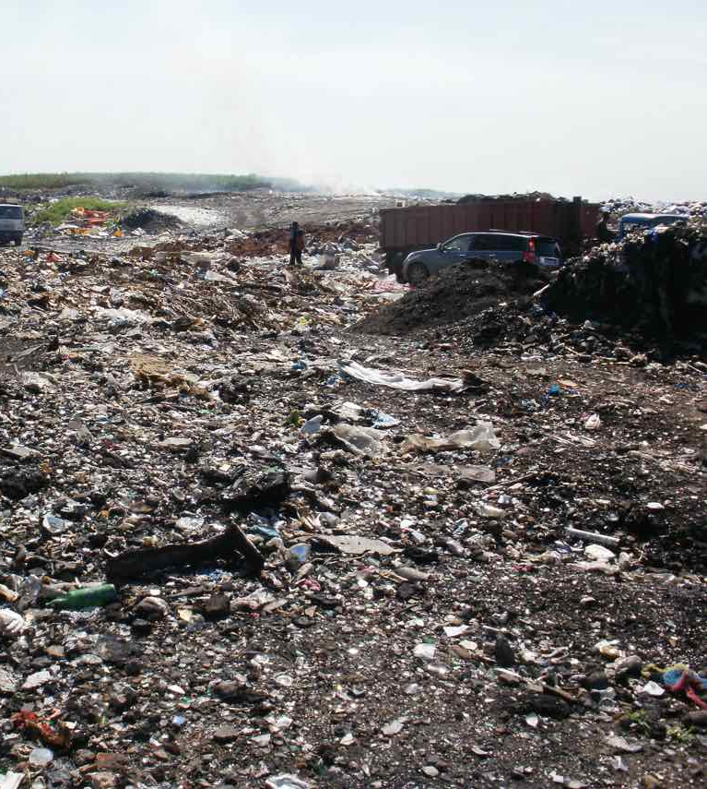
How do humans produce greenhouse gases?
Energy production
Electricity Generation
Across the world, significant volumes of waste are disposed of in landfills. In addition to many other negative environmental effects, the organic component of waste (e.g. food, wood) decomposes over time and releases methane. Methane is a greenhouse gas, with c. 21x the impact of the same volume of CO2.
Waste that is burnt also contributes to CO2 releases back to the environment.
Recycling and reuse mimimises the impact what we throw away has on the environment, and avoids the energy use involved in producing new products.
Heat Generation
Transport
Land use change
Waste Management

Slide 23
Greenhouse Gas diary
Describe five activities you carry out in a typical weekday that contributes to the production of greenhouse gases. What was the original (natural) source of carbon in each case?
Activity
Natural carbon source
1
2
3
4
5

Slide 24
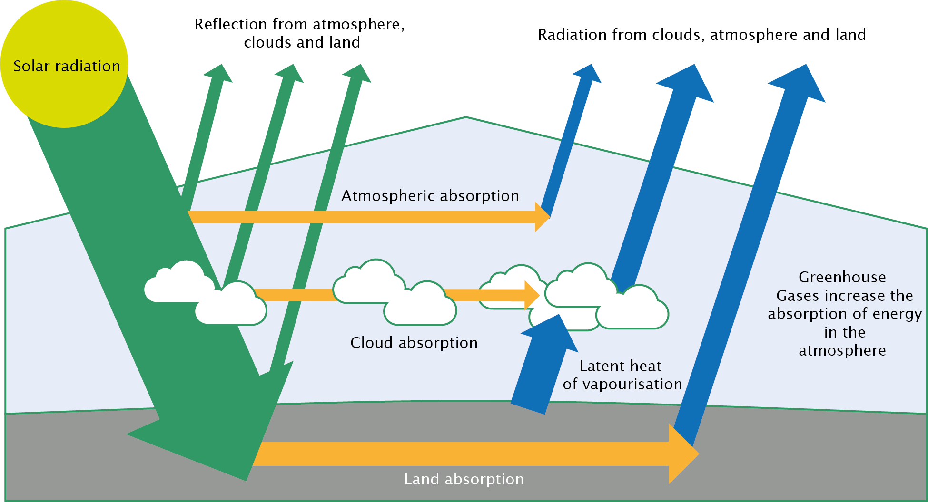
The man-made greenhouse effect

Slide 25
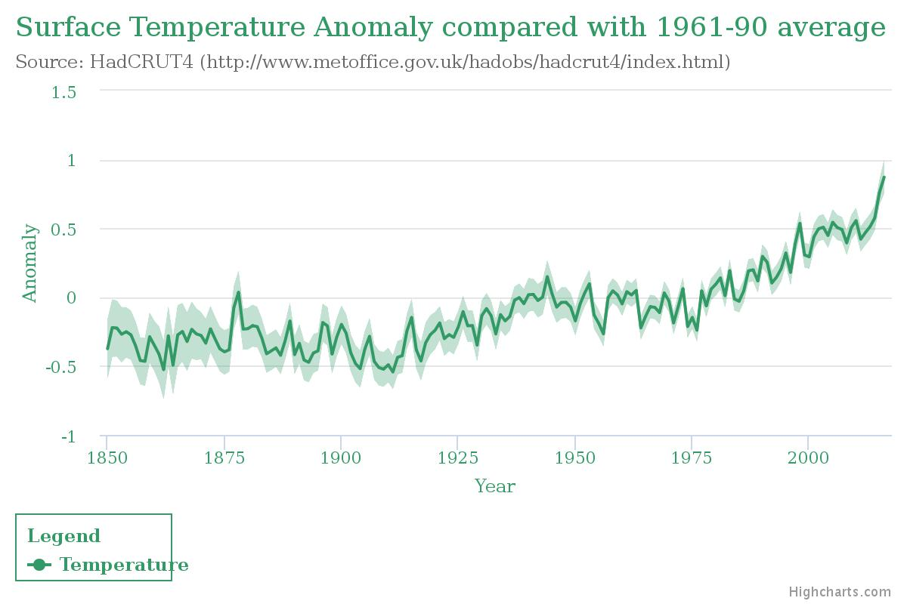
Earth surface temperatures are increasing
Increases vs. average
0 = 1961 – 1990 average
Decreases vs. average

Slide 26
The impact of CO2 increases
Lesson 4

Slide 27
The man-made greenhouse effect

Slide 28
Earth surface temperatures are increasing
Increases vs. average
0 = 1961 – 1990 average
Decreases vs. average

Slide 29
Temperature change is a primary effect of increased CO2, with multiple secondary effects
Primary impact
Secondary impacts
Change in temperature
Feedback loops that amplify or reduce the initial change
Lower albedo
More absorption of sun
Environmental impacts
Ice cap melting
Sea level rise (ice melt)
Sea level rise (expansion)
Changing ocean currents
Changing global energy distribution
Ocean acidification
Changes to sea life
Photosynthesis (biological pump)
Ecosystem distribution
Changes to vegetation
Extreme weather
Increased flooding
Melting permafrost
Organic decomposition
Methane release
Social impacts
Migration / displacement
Developing world development
Economic impacts
Economic cost of disasters
Changing patterns of food production

Slide 30
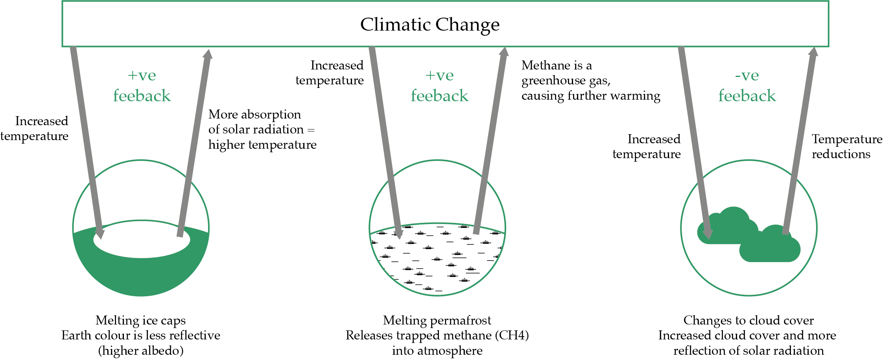
Feedback loops
Due to the complex interactions between the earth’s systems, an initial change in temperature has multiple secondary effects. Some of these effects act to increase (positive feedback) or decrease (negative feedback) the initial temperature change.

Slide 31
Impacts of a changing climate
Fill out the gaps below to describe how a changing climate would impact you, someone living in a developed word city and someone living a developing world small island state.
Factor | You | Developed World City | Developing small island state
Description | Think through the environment in which you live and how rising temperatures would impact the following: | James lives and works in a developed world city. The weather in this city is temperate as a result of ocean currents carrying warm water from equatorial regions. | Claire lives in a developing world small island state. She lives a subsistence lifestyle, with most foods consumed grown on the island. The island is low-lying and Claire lives in a house by the coast.
What will be the changes to the natural environment as a result of increased temperatures?
How will the ease and cost of securing food change as a result of the environmental changes above?
How is a higher frequency of extreme events likely to impact this person?
How will this persons daily routine change?
How easy is it for this person to adapt to their new environment?

Slide 32
Risk based approach to predicting effects
The climate is the result of the interaction of a number of complex earth systems. Predicting what will happen as a result of temperatures rising occurs as part of a risk based approach:
Complex system, multiple inputs and outputs
Potential risks
Probability
Magnitude
What are the risks associated with climate change?
How likely is it that the risk will occur?
How large is the impact if the risk does occur?
E.G. Sea level rise
Is it occurring already?
How direct are the links between cause (e.g. temperature increase) and effect (e.g. expansion of the oceans)?
What are the knock-on impacts (feedback loops)?
How sensitive are people / environments to sea level rise?
Using a risk-based approach, rank the following risks by scoring each on a scale of 1 (low) to 5 (high) for each of probability and magnitude:
Car does not start in the morning;
Rain in December;
Falling down stairs;
War;
House is broken into;

Slide 33
Dealing with the effects of climate change
MITIGATION
Mitigation seeks to reduce the primary causes of climate change, through reducing greenhouse gas emissions
e.g. solar electricity generation rather than coal
Change in temperature
Secondary environmental, social and economic effects
e.g. sea level rise
ADAPTATION
Adaptation allows societies and economies to adapt to changes in the environment that have been caused by climate change
e.g. building enlarged sea walls / flood defences
Identify 3 means of mitigating ands 3 means of adapting to the effects of climate change. What are the potential challenges with implementing these methods?

Slide 34
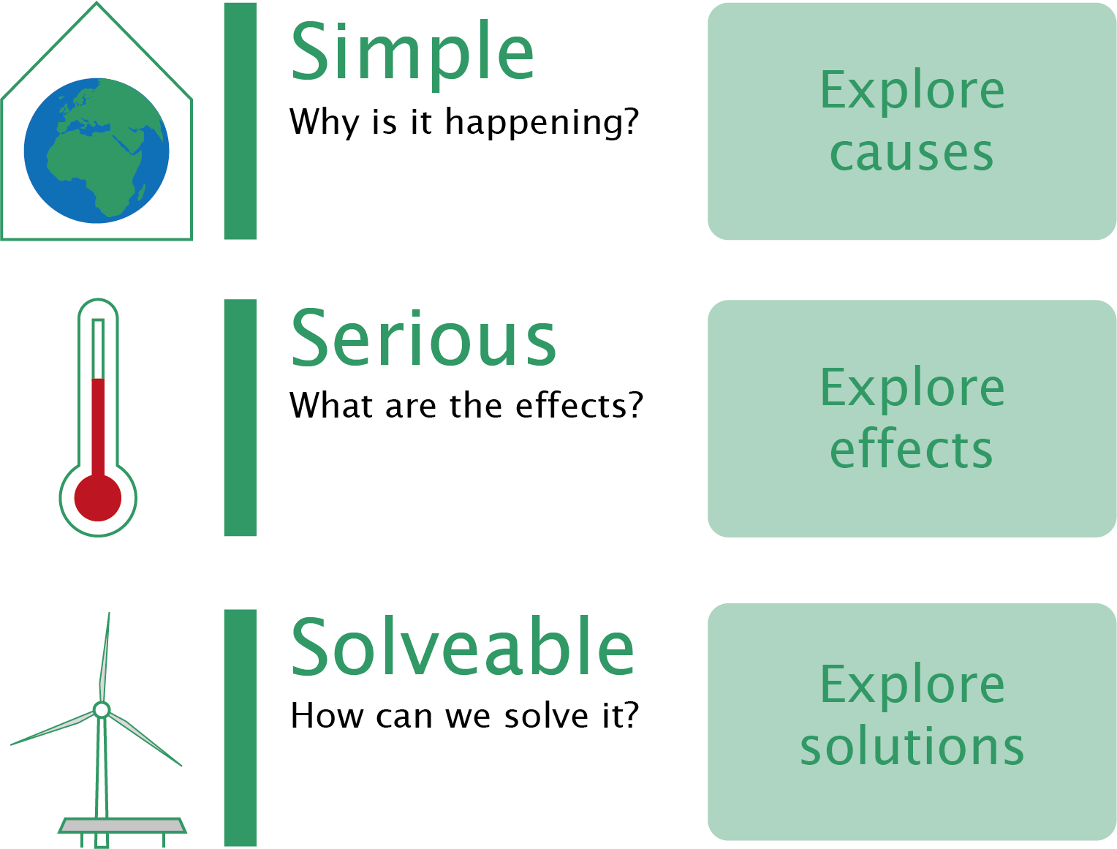
Climate change – overall summary
It’s simple – the Causes
It’s serious – the Effects
It’s solveable – the Solutions
Natural processes
Primary effects
Secondary effects
Mitigation
Milankovitch cycles
CO2 release
Ice cap melting
Renewable energy
Sunspots
Methane release
Sea level rise
Sustainable land use
Greenhouse Gases
El Nino
Nitrous Oxide
Ocean acidification
Geoengineering
Environmental
Volcanic eruptions
Water vapour
Ecosystem distribution
Carbon capture and storage
Feedback loops
Extreme weather
Energy efficiency
Human activities
Permafrost
Carbon consumption
Electricity
Enhanced greenhouse effect: Temperature Increases
Migration
Energy use
Heat
Social
Development pathways
Adaptation
Transport
Solar irradiation
Disease
Relocation
Land use change
Particulates
Economic costs
Behavioural changes
Waste management
Economic
Infrastructure
Food production
Reduction in emissions from human activities

